Slide 1
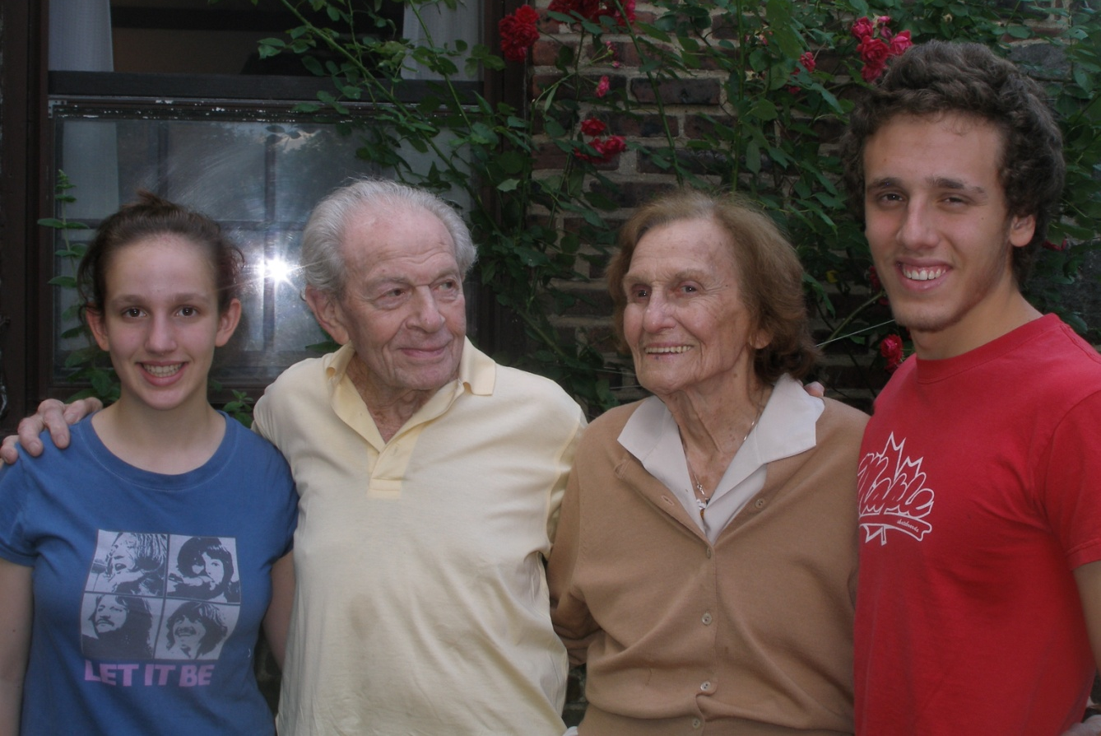
Evolution of Aging
Notes:
Age is a very high price to pay for maturity (Tom Stoppard)
Prospero in The Tempest says “We are such stuff as dreams are made on, and our little life is rounded with a sleep.”
How did Mark Twain put it? “I was dead for millions of years before I was born and it never inconvenienced me a bit.”

Slide 2
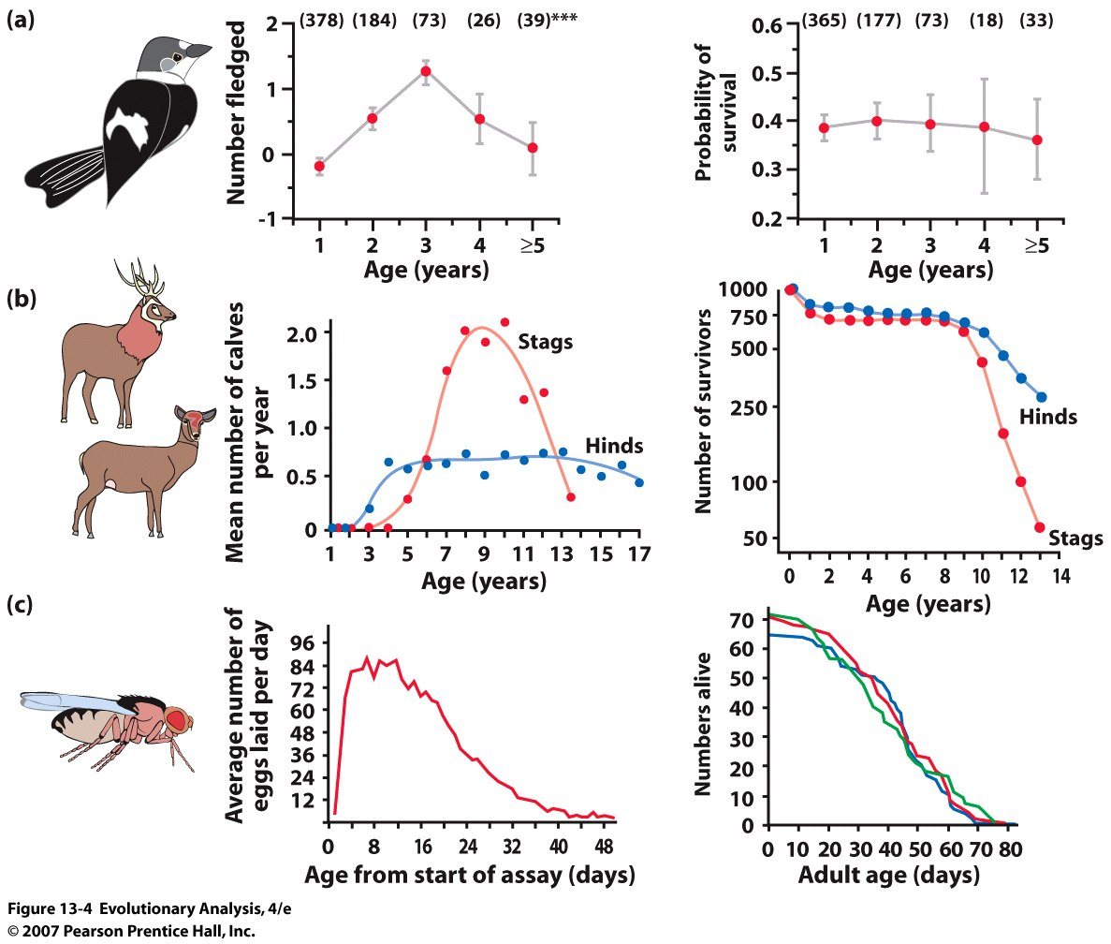
I. Evidence for senescence and evidence for the evolution of senescence
Notes:
Figure 13.4 Aging in three animals
(a) Aging in a bird. For females in a wild population of collared flycatchers (Ficedula albicollis), the number of young fledged each year declines after age 3 (age-related differences in number fledged are significant at P < 0.001). The probability of survival from one year to the next declines slightly, but not significantly, after age 2. Sample sizes in parentheses. From Gustafsson and Part (1990). (b) Aging in a mammal. For males in a wild population of red deer (Cervus elaphus), the number of calves fathered each year declines sharply after a peak at about age nine; for females, the number of calves produced each year declines gradually starting at about age 13. For both sexes, the probability of surviving from one year to the next is nearly 100% from age 2 to 9. After age 9, the probability of surviving plummets. From Clutton-Brock et al. (1988). (c) Aging in an insect. For females in a laboratory population of fruit flies (Drosophila melanogaster), the average number of eggs laid per day declines after the age of about 12 days. In three laboratory populations, the probability of surviving from one day to the next falls at the age of about 20 days. Modified from Rose (1984).

Slide 3
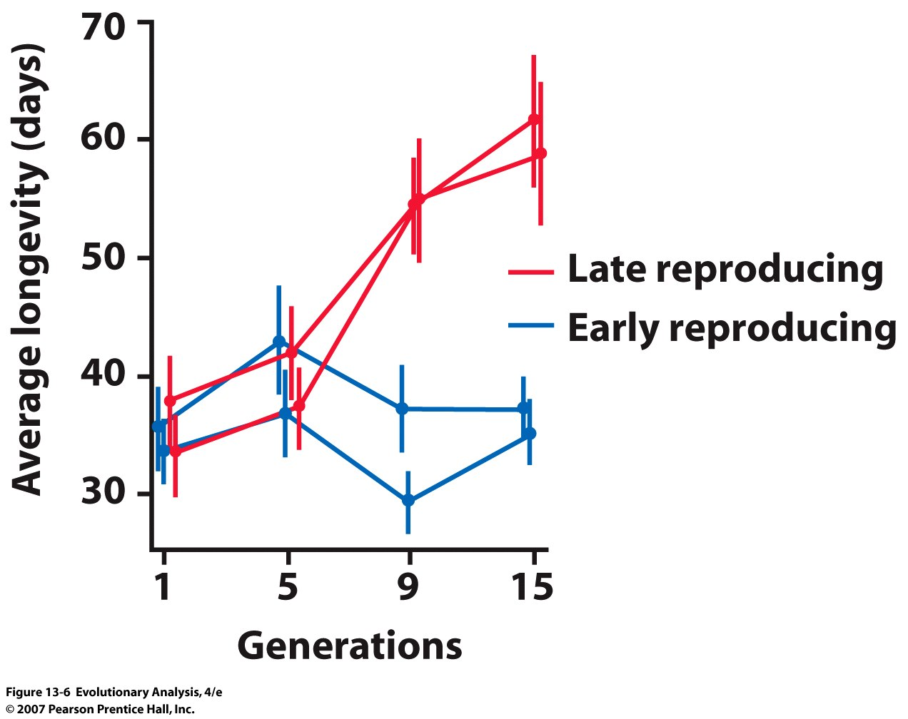
Artificial selection increases life span in fruit flies
Inherent limits, or can lifespan evolve?
Fruit fly expt:
Notes:
Figure 13.6 Artificial selection increases life span in fruit flies
The graph shows average life span in each of four laboratory populations of Drosophila melanogaster over 13 generations of selection. The vertical lines show the 95% confidence intervals for the estimated population averages. From Luckinbill et al. (1984).

Slide 4
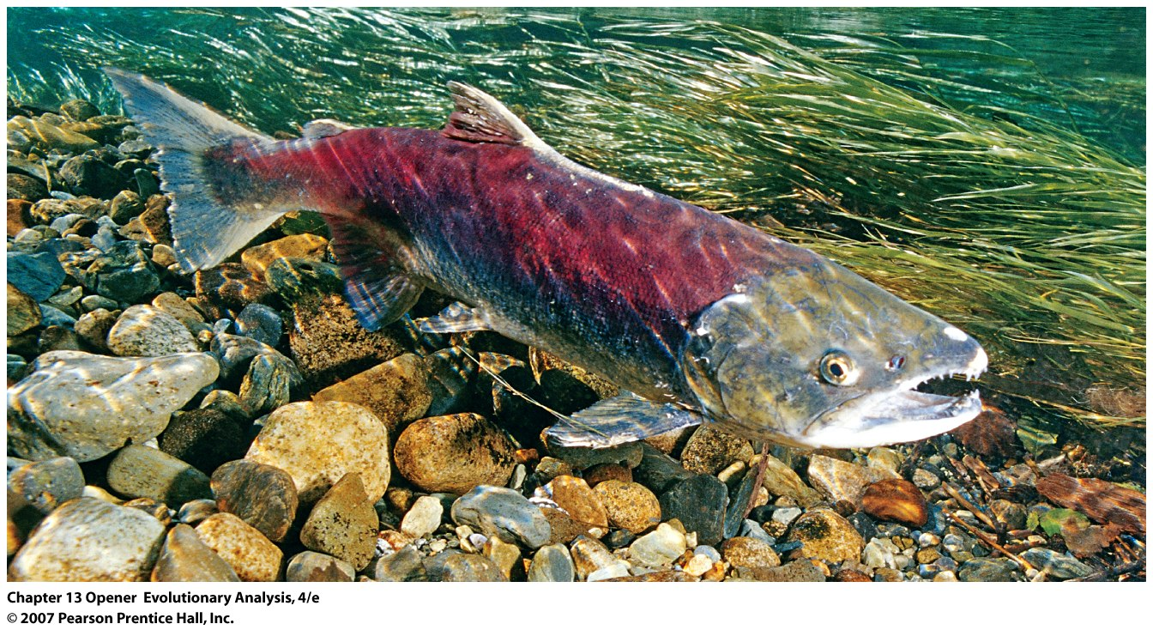
II. Fundamental Trade-offs
Female sockeye salmon defending its nest before dying

Slide 5
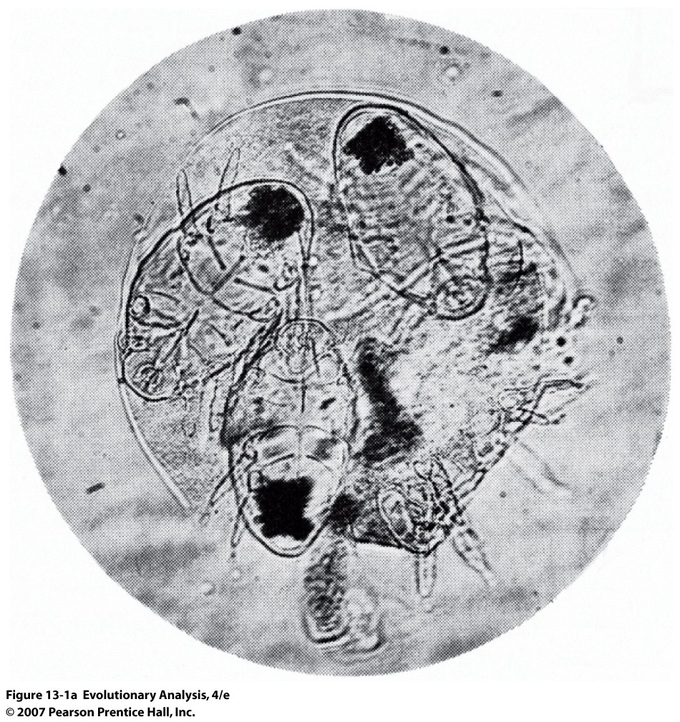
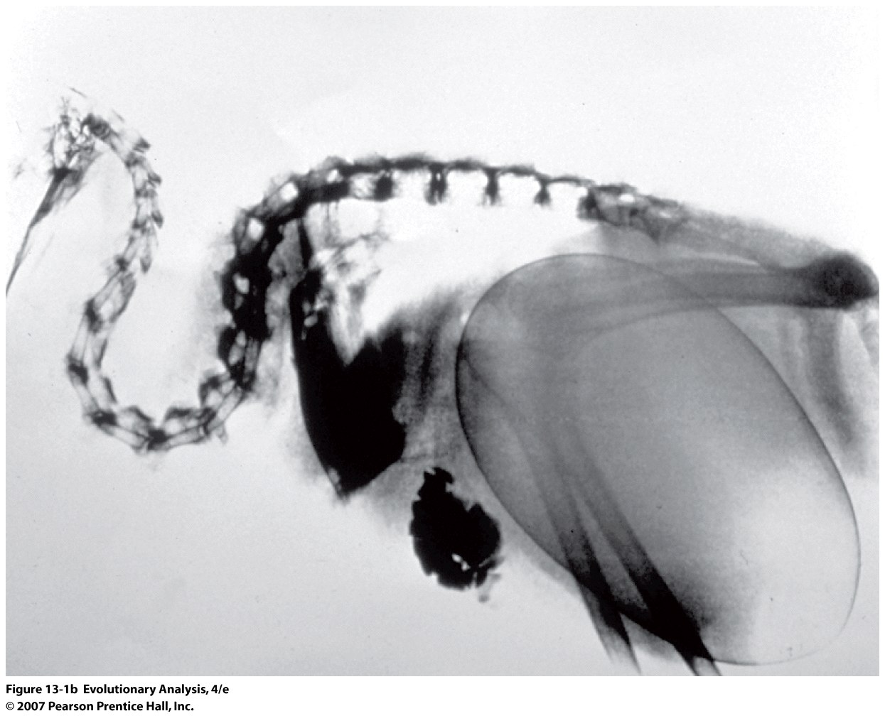
Mite Kiwi bird
Notes:
Figure 13.1a Extreme reproductive strategies
Having devoured their mother from the inside, three thrips egg mites (Adactylidium sp.) prepare to depart her empty cuticle. The mother's legs are visible at lower right (180x). Reproduced by permission from Elbadry and Tawfik (1966).
Kiwi bird, 20% of wt towards egg

Slide 6
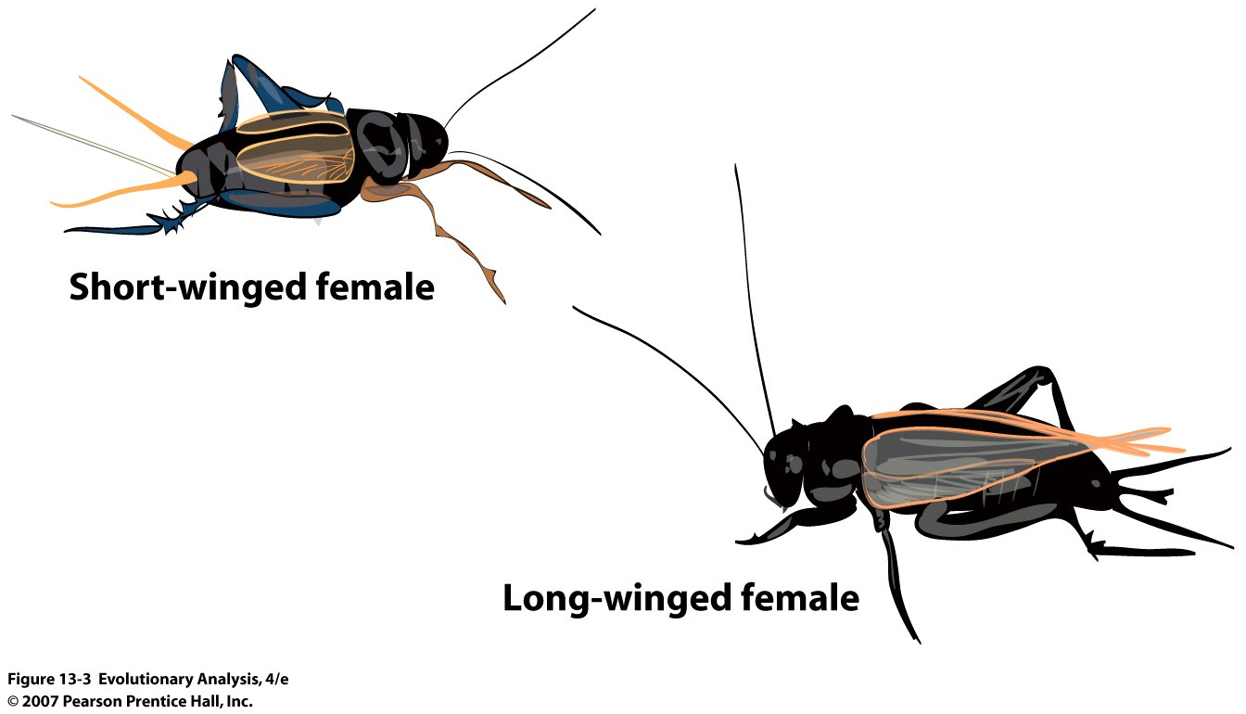
Short-winged and long-winged morphs of female sand crickets (Gryllus firmus)
Notes:
Figure 13.3 Short-winged and long-winged morphs of female sand crickets (Gryllus firmus)

Slide 7
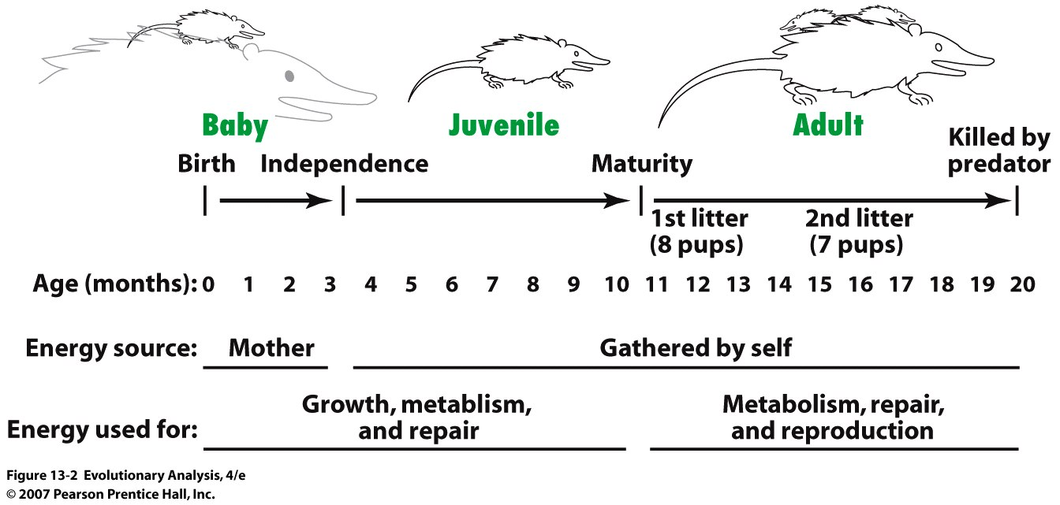
The life history of a hypothetical female Virginia opossum (Didelphis virginiana)
Notes:
Figure 13.2 The life history of a hypothetical female Virginia opossum (Didelphis virginiana)
This hypothetical female has a life history typical of female Virginia opossums living in the mainland United States (Austad 1988; 1993). Figure designed after Charnov and Berrigan (1993).

Slide 8
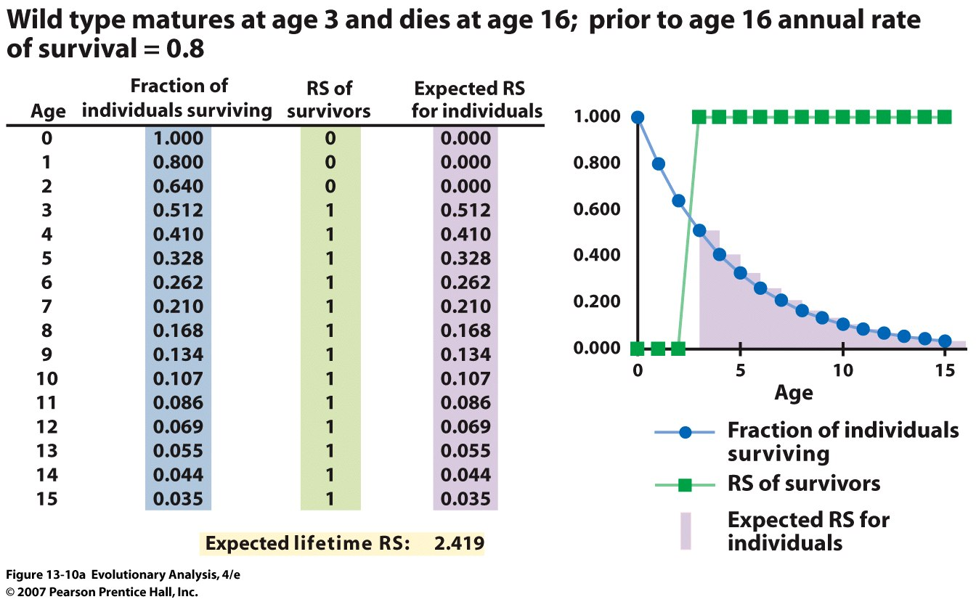
III. Evolutionary theories of aging
Background:
Expected Reproductive Success (RS) = Prob(Surviving) x #(Offspring)
Notes:
Figure 13.10a A simple genetic model reveals two mechanisms through which aging can evolve
(a) The life history of individuals with the wild-type genotype. The sum of the values in column 4 gives the expected lifetime reproductive success of wild-type individuals: 2.419.

Slide 9
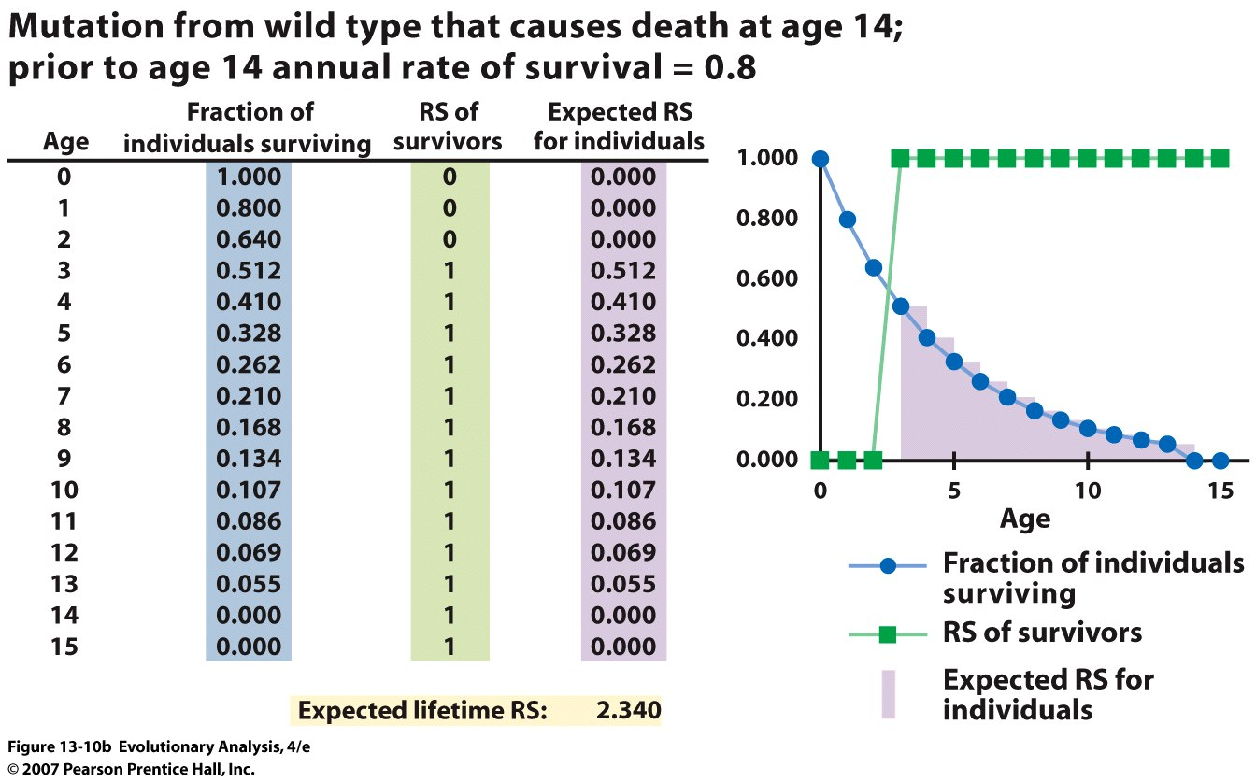
Versus 2.419
Notes:
Figure 13.10b A simple genetic model reveals two mechanisms through which aging can evolve
(b) The life history of individuals with a mutation that causes death at age 14. The expected lifetime reproductive success of individuals with this mutation is 2.340. The mutation is deleterious, but not extremely so.

Slide 10
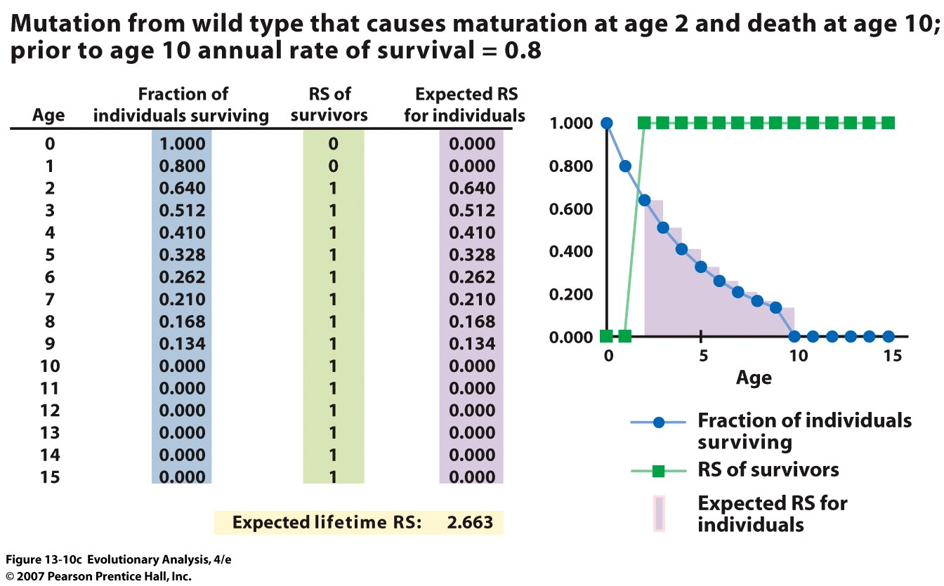
Versus 2.419
Notes:
Figure 13.10c A simple genetic model reveals two mechanisms through which aging can evolve
(c) The life history of individuals with a mutation that causes maturation at age 2 and death at age 10. The expected lifetime reproductive success of individuals with this mutation is 2.663. The mutation is advantageous. See text for more details.

Slide 11
Two Theories
Senescence reflects relaxed selection (drift)
increased expression of deleterious recessive alleles
increased genetic variation later in life
B. Senescence reflects tradeoffs
loci involved in senescence have early fitness effects
balancing selection signature
Notes:
Not mutually exclusive

Slide 12
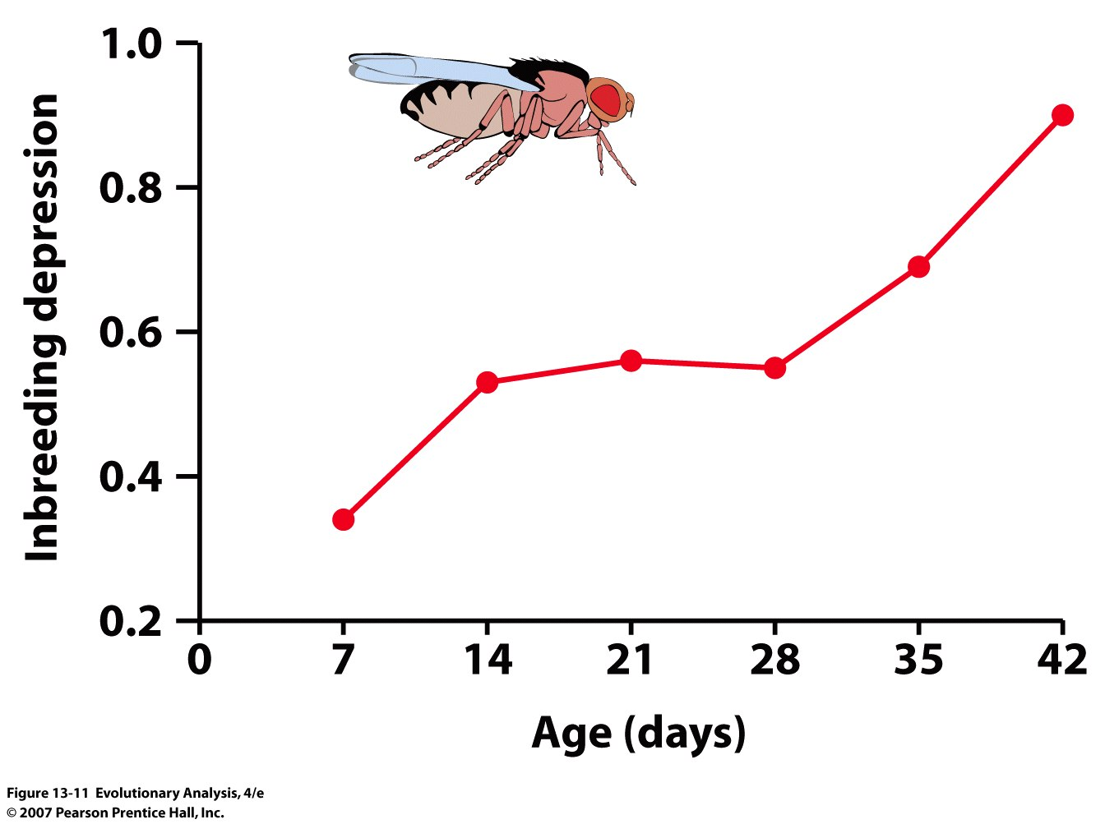
Mutation Accumulation Hypothesis (drift, non selection)
Mutations expressed later in life, near the end of reproduction
are effectively neutral
Notes:
Figure 13.11 An increase in inbreeding depression with age consistent with the mutation accumulation hypothesis of senescence
If inbreeding depression is caused by recessive deleterious alleles and if natural selection acts more weakly against late-acting deleterious alleles, then inbreeding depression should increase with age. This graph, tracking inbreeding depression as a function of age in laboratory fruit flies, shows that it does. Drawn from data in Hughes et al. (2002).

Slide 13
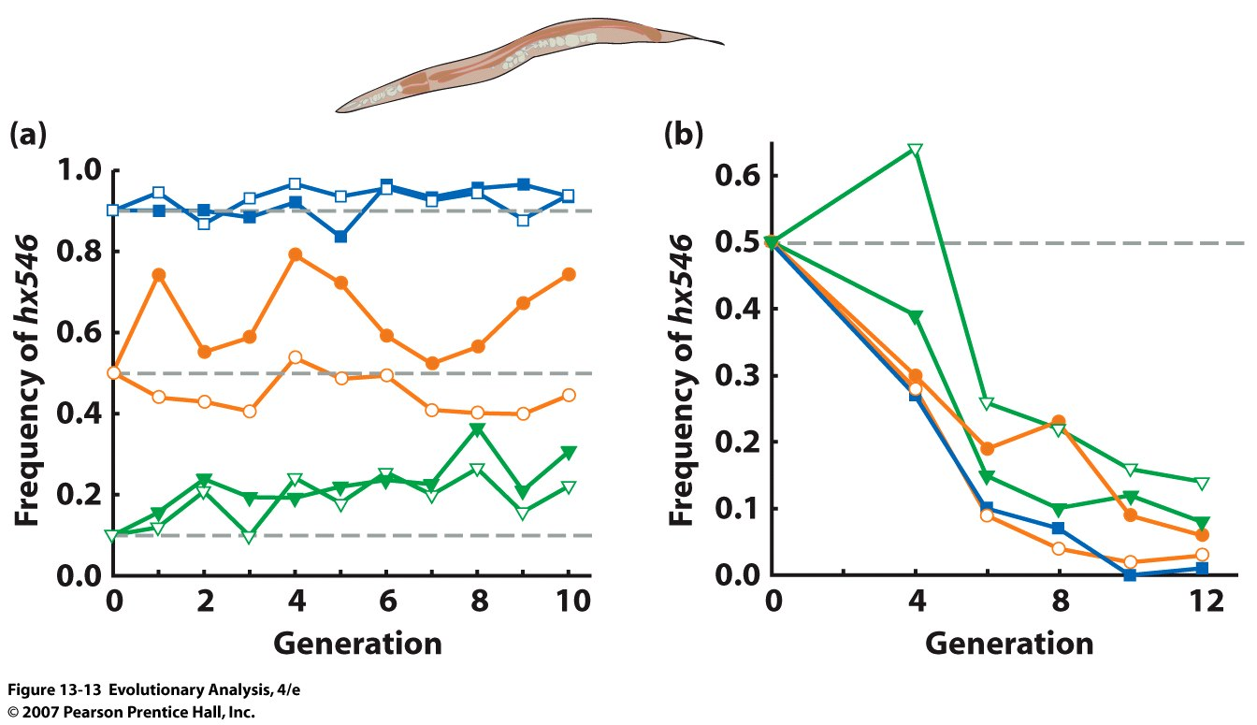
B. Antagonistic Pleiotropy Hypothesis
The longevity allele hx546 under (a) benign and (b) stressful conditions
Notes:
Figure 13.13 Under semi-natural conditions, the age-1 gene in the nematode worm C. elegans exhibits antagonistic pleiotropy
This graph tracks the frequency of the hx546 allele of the age-1 gene, which causes increased longevity, in six experimental populations reared in the lab with ample food. The frequency of hx546 changed little over 10 generations, regardless of its starting frequency, indicating that the allele was effectively neutral. (b) This graph tracks the frequency of the hx546 allele in five populations reared under semi-natural conditions characterized by periodic bouts of starvation. The frequency of hx546 declined rapidly over 12 generations in all five populations, indicating that the allele was strongly selected against. From Walker et al. (2000).
But little evidence that candidate gene approach explains variation in natural populations

Slide 14
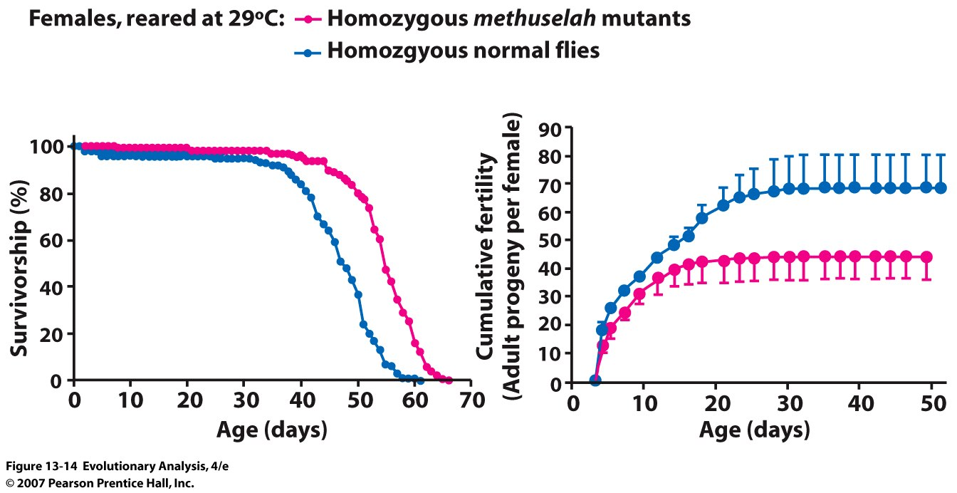
Trade offs in fruit flies between longevity and reproduction
Notes:
Figure 13.14 The methuselah gene controls a trade-off between reproductive success versus longevity and stress resistance
Normal female fruit flies die younger than homozygous methuselah mutants (a), but they have considerably higher lifetime reproductive success (b). These patterns, detected at 29 degrees C, change at other temperatures. Redrawn from Mockett and Sohal (2006).
At least one gene for which mutations strongly
affect lifespan in D. melanogaster (Methuselah or Mth)
also exhibits extensive natural polymorphism, a natural
cline in allele frequencies that parallels a cline in lifespan,
and a molecular signature of selection
(Schmidt et al. 2000). Mutant analysis can therefore
potentially reveal genes contributing to natural variation.
Such genes can then be subjected to
functional and evolutionary analyses that test model
predictions. This path is not easy, however. Although
the effects of Mth on lifespan have been recognized
for more than a decade (Lin et al. 1998), natural allelic
variation at this gene has still not been directly implicated
in the clinal variation in lifespan (Paaby &
Schmidt 2008). Of the many candidate genes nominated
by mutagenic or transgenic manipulation, Mth
is the only one that has been formally associated with
natural variation in lifespan or ageing. More generally,
loci contributing to natural variation in traits such as
lifespan, starvation resistance and male mating behaviour
show little overlap with those known to have large
effects on the same phenotypes when mutated
(Mackay et al. 2009). These results suggest that the
candidate-gene approach is not an efficient one for
documenting the genetic basis of natural variation in
senescence.
4.

Slide 15
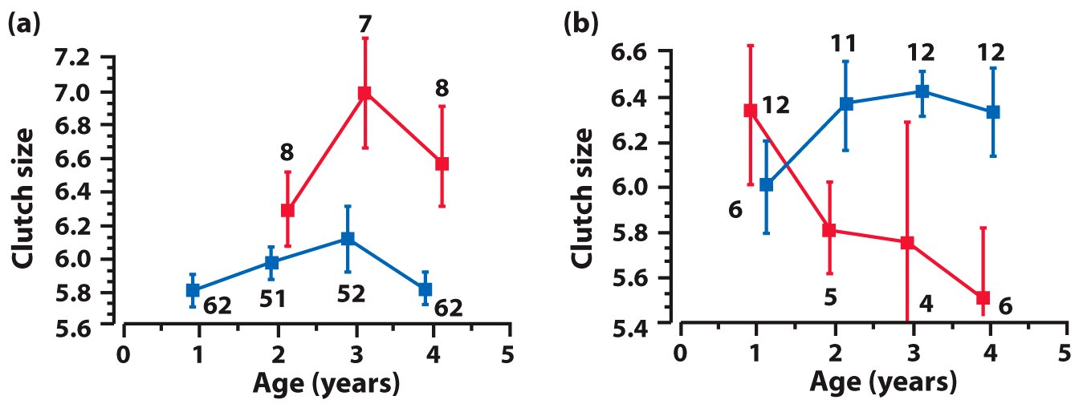
Collared flycatchers: (a) natural variation and (b) experimental manipulations
Extra eggs
Notes:
Figure 13.15 In collared flycatchers (Ficedula albicollis), natural variation and experimental manipulations demonstrate a trade-off between reproduction early in life versus reproduction late in life
(a) Females that first breed at age 1 (blue boxes) have smaller clutches at ages 2, 3, and 4 than females that do not breed until age 2 (red boxes). The error bars indicate the standard errors of the estimated mean clutch sizes; the numbers above the symbols give the sample sizes. (b) Females given extra eggs at age 1 (red boxes) have progressively smaller clutches each year at ages 2, 3, and 4. In contrast, control females (blue boxes) do not begin to show a decline in clutch size until age 4. Note that the vertical scales are different. From Gustafsson and Pärt (1990).

Slide 16
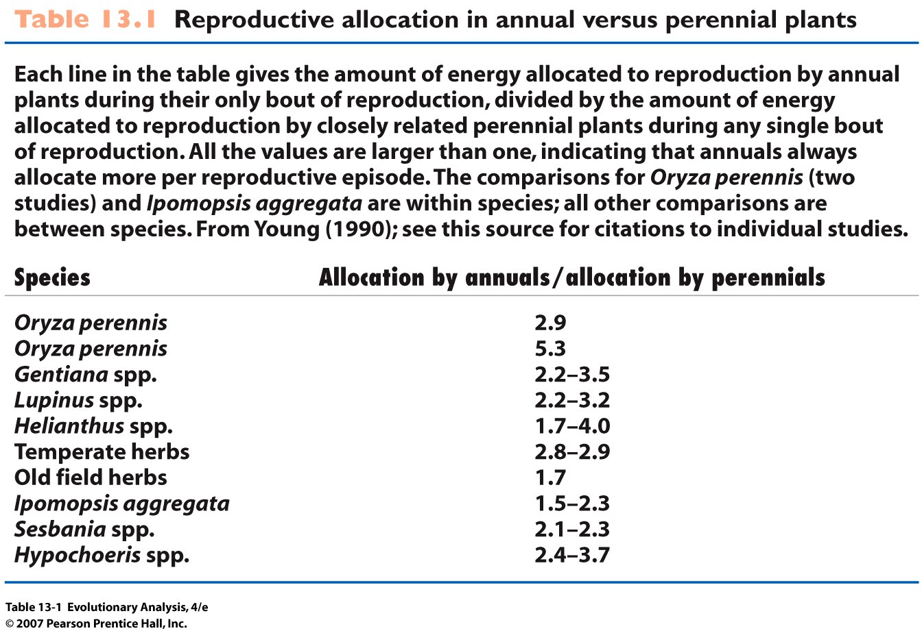
Notes:
Table 13.1 Reproductive allocation in annual versus perennial plants

Slide 17
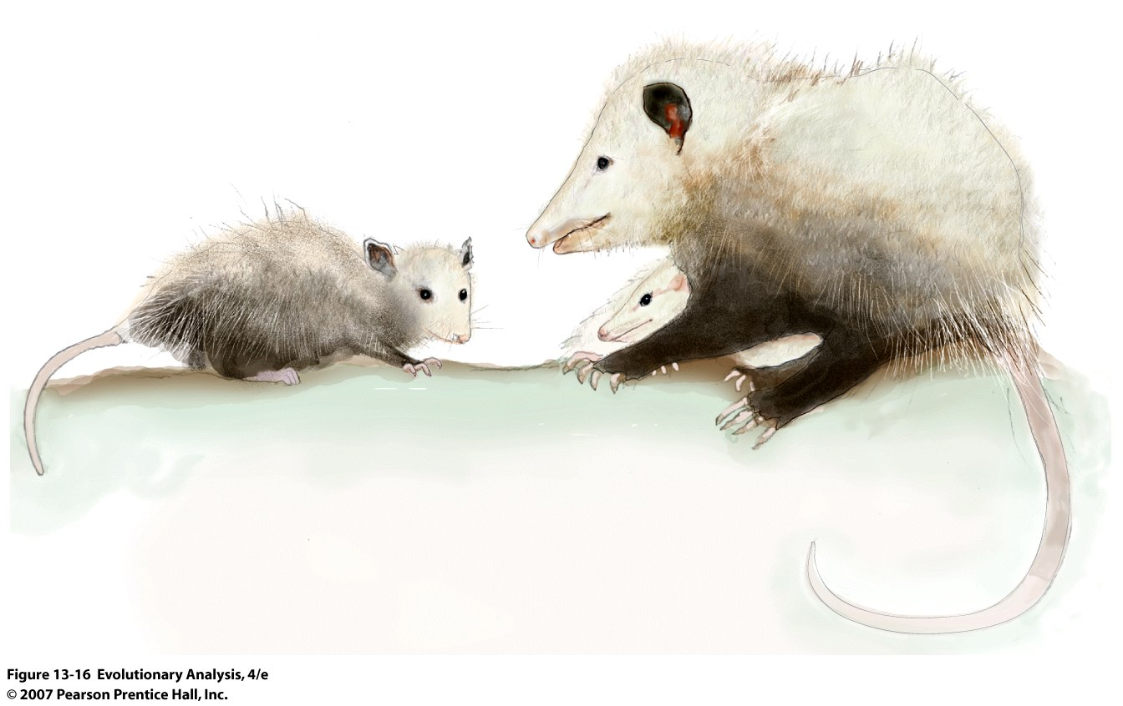
Notes:
Figure 13.16 A Virginia opossum and her young
Opossums, like other marsupials, have relatively short life spans for mammals. But opossums in some populations have shorter life spans than opossums in others. This suggests that rates of aging evolve in nature.

Slide 18
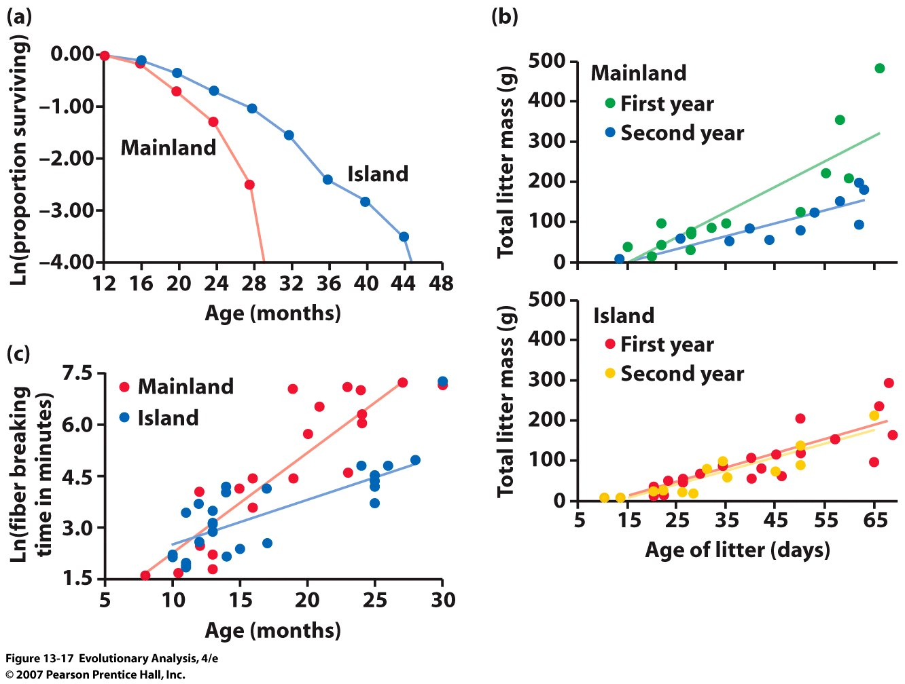
Mainland Georgia versus Island populations
Differences in mortality
Differences maternal ability
Physiological deterioration
Notes:
Figure 13.17 Female opossums on Sapelo Island age more slowly than female opossums on the mainland
The rate of survival from one month to the next falls more rapidly with age for mainland opossums than for island opossums. (b) Each graph shows total litter mass as a function of litter age for females in their first year of reproduction (green or red) and for females in their second year of reproduction (blue or yellow). In mainland females (top graph), offspring in second-year litters grow more slowly than offspring in first-year litters (P < 0.001). In island females, second-year litters grow just as fast as first-year litters. (c) Tail collagen fiber-breaking time increases more slowly with age in island females than in mainland females (P < 0.001). From Austad (1993).
Trade-offs or accumulation of deleterious mutations?
Island possums have smaller litter sizes (5.66) than mainland (7.61).

Slide 19
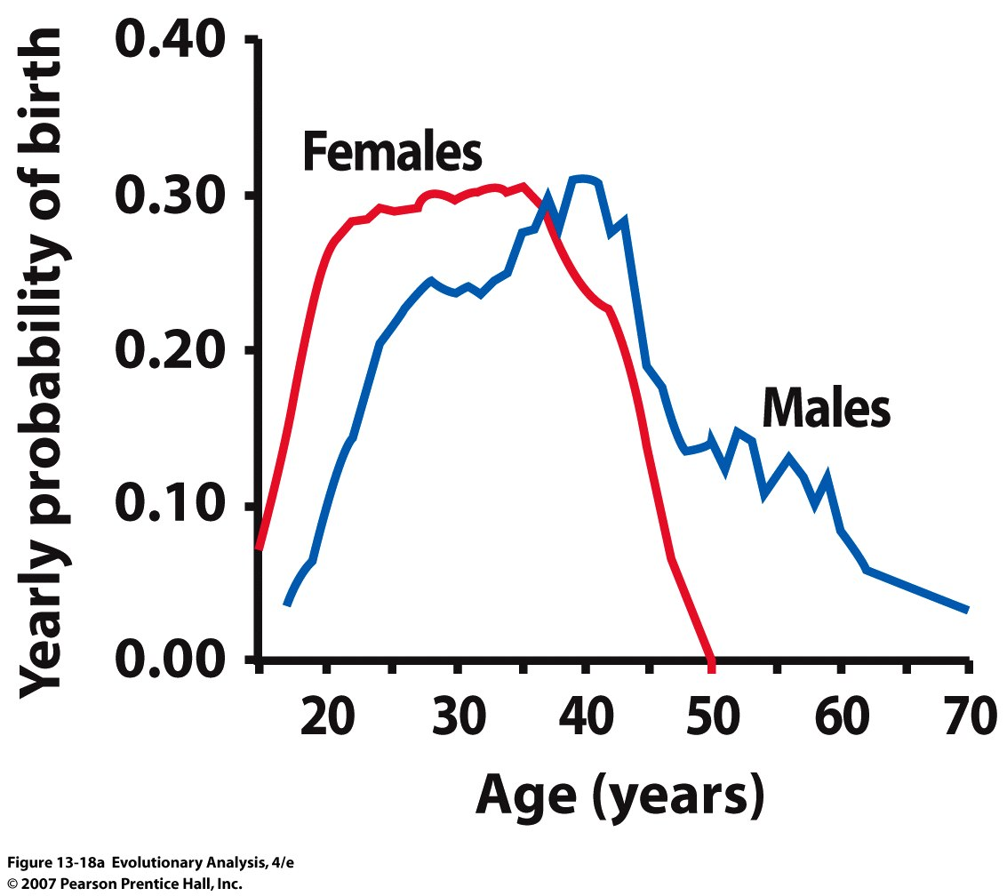
IV. Evolution of Senescence and Human Reproduction
Notes:
Figure 13.18a Data on menopause
(a) Reproductive senescence in women and men. These data are from the Ache, hunter-gatherers of Paraguay. The graph shows the probability that women and men will have a child born during the year that they are any given age. From Hill and Hurtado (1996).

Slide 20
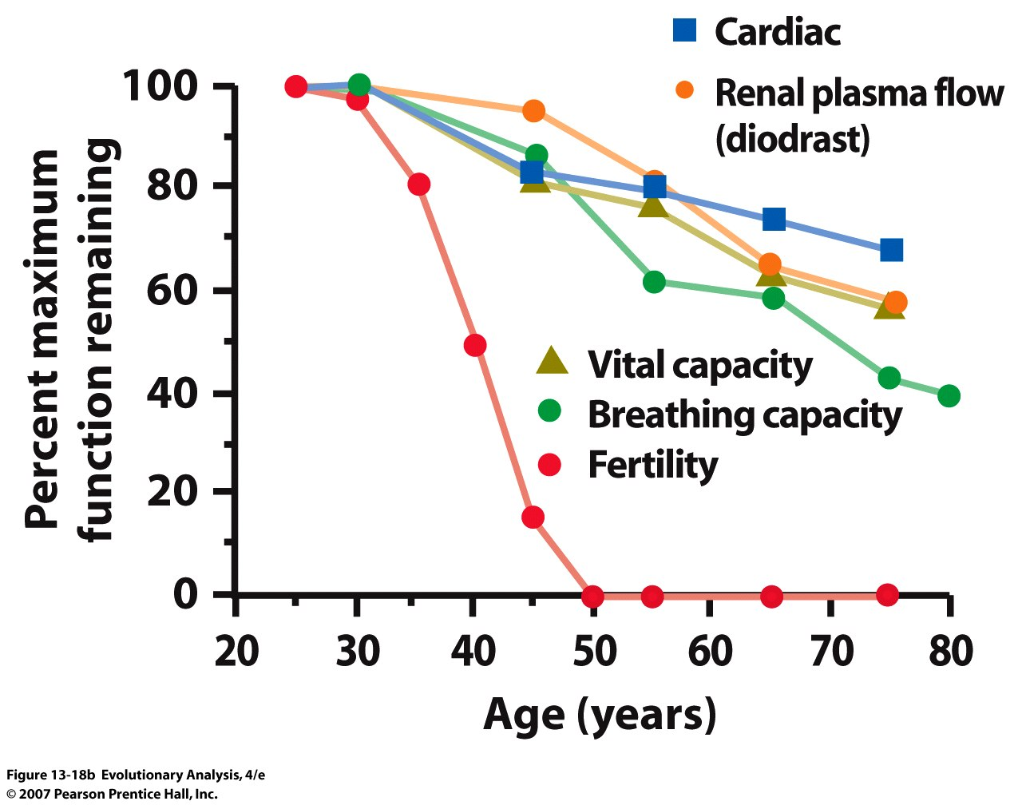
Functional capacity of various physiological systems in women as a function of age
from Ache hunger-gathers of Paraguay
Notes:
Figure 13.18b Data on menopause
(b) This graph shows the functional capacity of various physiological systems in women as a function of age. Capacity is calculated as the fraction of youthful capacity still remaining. From Hill and Hurtado (1991); see citations therein for sources of data.

Slide 21
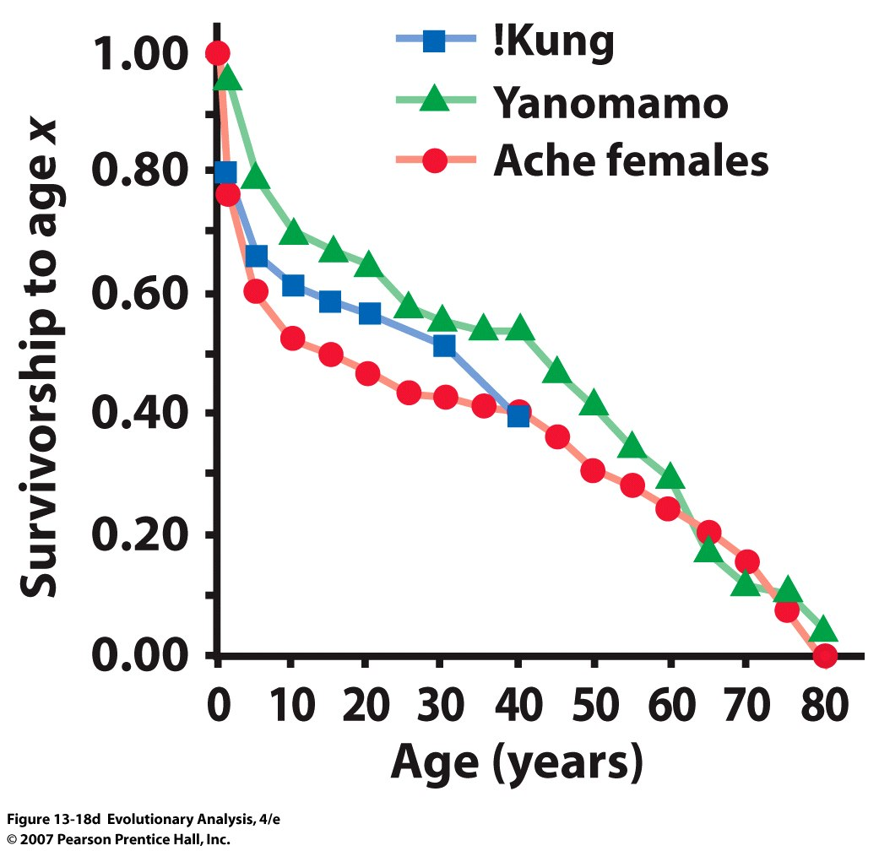
Menopause an artifact of living longer?? Probably NOT
Notes:
Figure 13.18d Data on menopause
(d) Fraction of individuals surviving as a function of age in three hunter-gatherer cultures. From Hill and Hurtado (1991); see citations therein for sources of data.

Slide 22
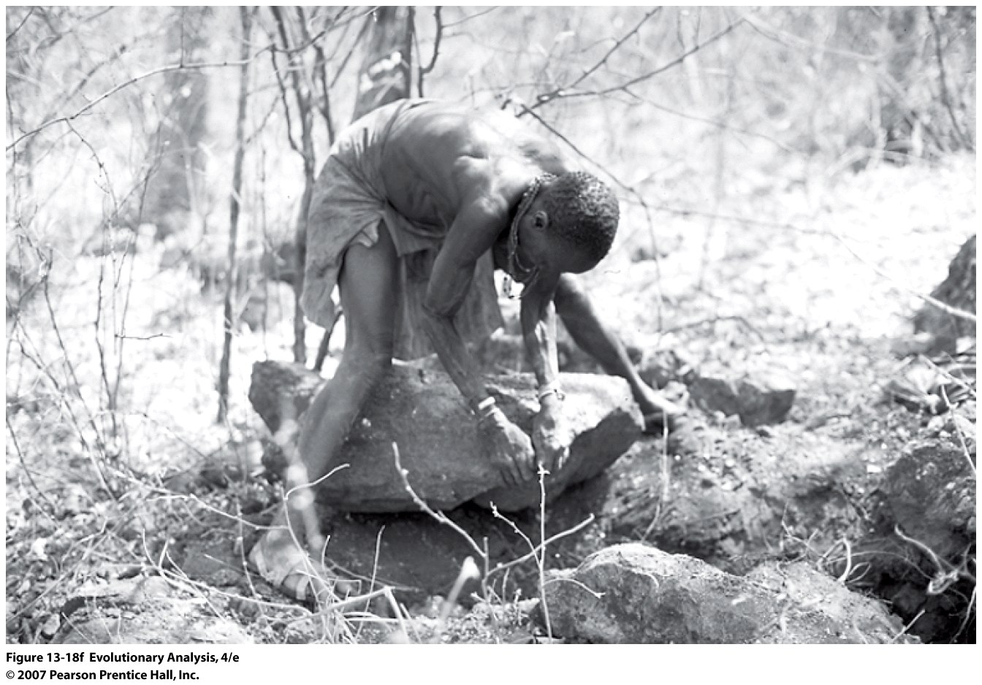
Hazda Woman (hunter-gatherer from East Africa)
Notes:
Figure 13.18f Data on menopause
(f) This Hadza woman is approximately 65 years old. She is using a digging stick and muscle power to dig tubers from underneath large rocks. Digging tubers requires knowledge, skill, patience, strength, and experience, making Hadza grandmothers the most productive foragers.

Slide 23
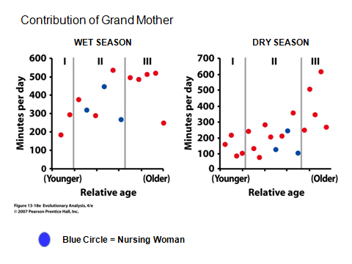
Notes:
Figure 13.18e Data on menopause
(e) Time spent foraging each day during the wet season (left) and the dry season (right) by Hadza women of different ages: I = women who have reached puberty, but not yet married or begun to have children; II = women who are pregnant or have young children; III = women who are past childbearing age and have no children younger than 15. Blue circles represent women nursing young children. From Hawkes et al. (1989).

Slide 24
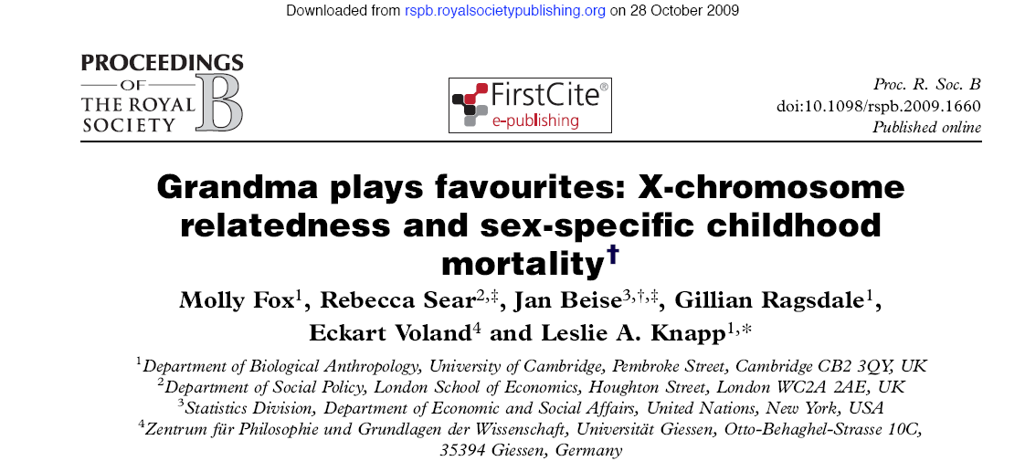

Slide 25
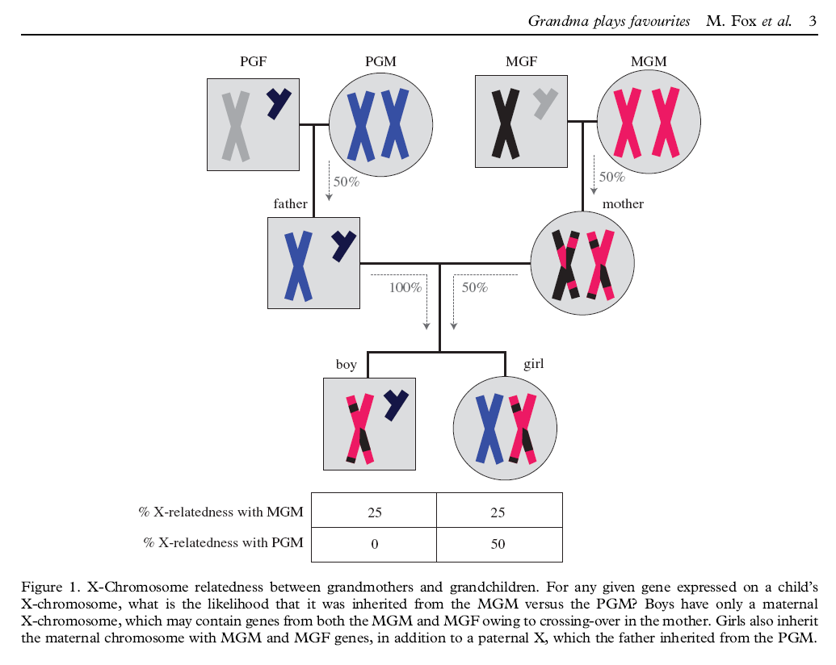

Slide 26
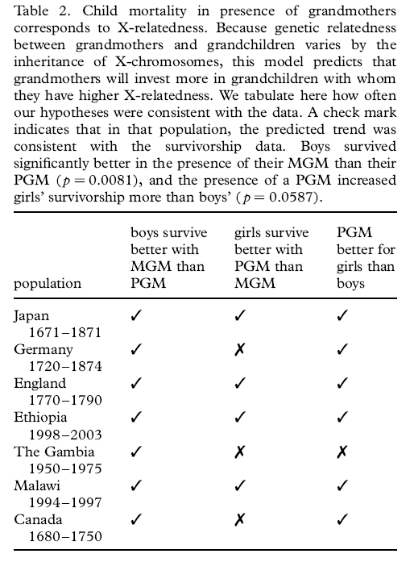

Slide 27
Conclusion
All organisms die
The timing of reproduction and death can evolve
Two evolutionary theories of senescence:
Mutation Accumulation
&
Antagonistic Pleiotropy
Human Menopause may be explained by inclusive fitness

